Slide 1
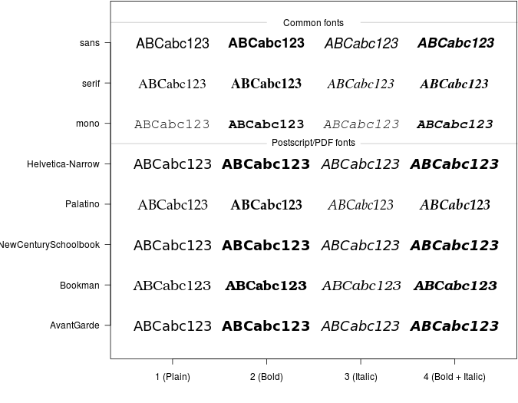
Play with fonts
in R

Slide 2
grDevices: The R Graphics Devices and Support for Colours and Fonts

Slide 3
rvg: R Graphics Devices for Vector Graphics Output

Slide 4
officer: Manipulation of Microsoft Word and PowerPoint Documents

